Slide 1
CPE 656
Software Engineering Studio I
Train Location Project
University of Alabama in Huntsville
October 12, 2015
Stephen Jalbert
Rashad Madyun
Corey Sanders

Slide 2
WORK PRODUCTS
Status
Process Document: Complete
Configuration Management Document: Complete
SRS: Awaiting customer review of features. Drafting initial software requirements

Slide 3
WORK PRODUCTS
Agenda (10/12 – 10/19)
ROM
  Await Feedback
Process Document
  Await Feedback
Configuration Management Document
  Await Feedback
SRS
  Finish Draft of Software / Hardware Requirements.
  Await Feedback for System Requirements.
  Start Modeling of Requirements Analysis

Slide 4
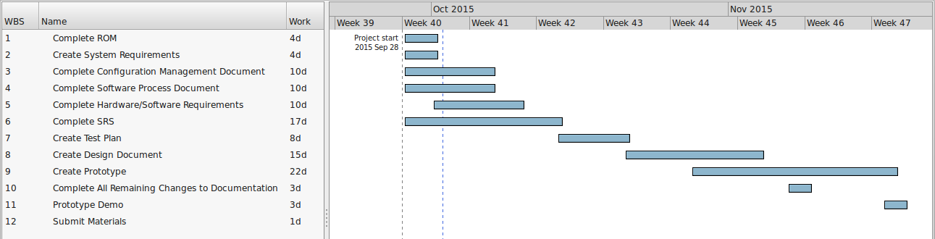
Schedule

